Slide 1
Stock Market Prediction
DOMAIN: MINI PROJECT-2

Slide 2
Objective
The objective of this project is to design a deep learning model that does predictions based on technical analysis.
The data that will be fetched will have the price information under regular time intervals with its respective characteristics.

Slide 3
Problem Statement
To implement instance-based learning algorithm, for predicting changes in stock index prices in the nifty-fifty market in short run, from historical time series data of quantitative factors that affect stock prices

Slide 4
Scope
Analysis of stocks will be useful for new investors to invest in stock market based on the various factors considered by the software.
This software will be analyzing Sensex based on company’s stock value. The stock values of company depend on many factors, some of them are:
Demand and Supply
Corporate results
Popularity

Slide 5
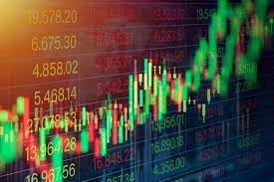
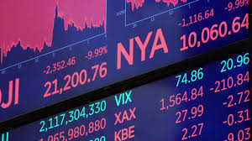
What Is Stock Market?
A stock or an equity is a security that represents the ownership of a fraction of a corporation.
This entitles the owner of the stock to a proportion of the corporation's assets and profits equal to the amount of stock that they own.
These units of stock are called shares.
The stock market is the collection of markets and exchanges where regular activities of buying, selling and issuance of shares of publicly held companies take place.

Slide 6
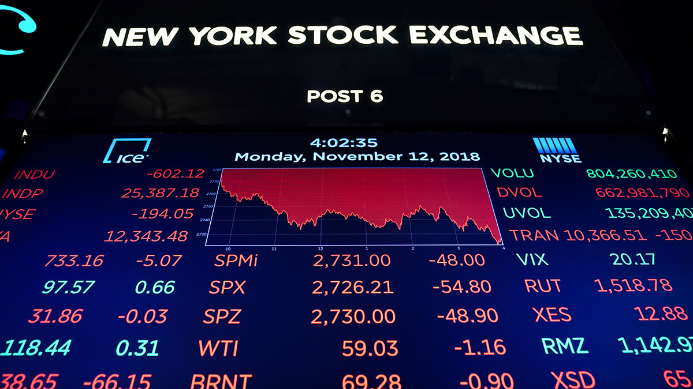
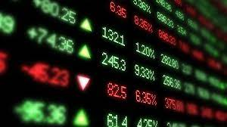
What Is Stock Market?
Stock exchanges are secondary markets, where existing owners of shares can transact with potential buyers.
The secondary market is where investors buy and sell securities they already own. It is what most people typically think of as the "stock market," though stocks are also sold on the primary market when they are first issued.

Slide 7
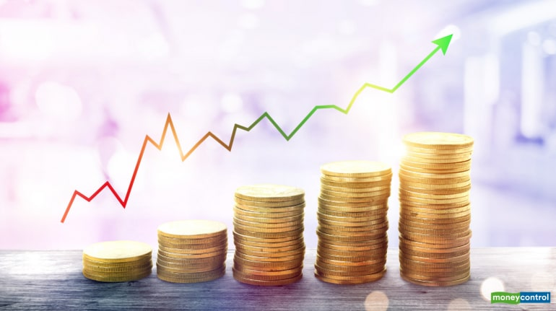

What Is Stock Market?
The corporations listed on stock markets do not buy and sell their own shares on a regular basis.
When you buy a share of stock on the stock market, you are not buying it from the company, you are buying it from some other existing shareholder.

Slide 8
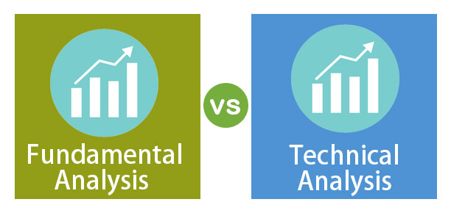
There are two different kinds of analysis techniques to predict the rise and fall of the stocks. They are-
Technical analysis
Fundamental analysis

Slide 9
Technical Analysis
Technical analysis focuses on analyzing the direction of prices to predict future prices.
You might have come across people drawing different lines and curves on the price chart to predict the future price direction.
Technical analysis is a pure number game where we have a bunch of numeric past information which has to be mapped to a number which we expect to be the future price which suits to be a perfect problem to be solved using Deep learning.

Slide 10
Technical Indicators
Technical indicators are heuristic or pattern-based signals produced by the price, volume, and/or open interest of a security or contract used by traders who follow technical analysis.
By analyzing historical data, technical analysts use indicators to predict future price movements. Examples of common technical indicators include
The Relative Strength Index (RSI)
Simple moving average

Slide 11
What Is a Moving Average (MA)?
A moving average (MA) is a stock indicator that is commonly used in technical analysis.
The reason for calculating the moving average of a stock is to help smooth out the price data over a specified period of time by creating a constantly updated average price.
Moving average is a simple, technical analysis tool. Moving averages are usually calculated to identify the trend direction of a stock or to determine its support and resistance levels. It is a trend-following—or lagging—indicator because it is based on past prices.

Slide 12
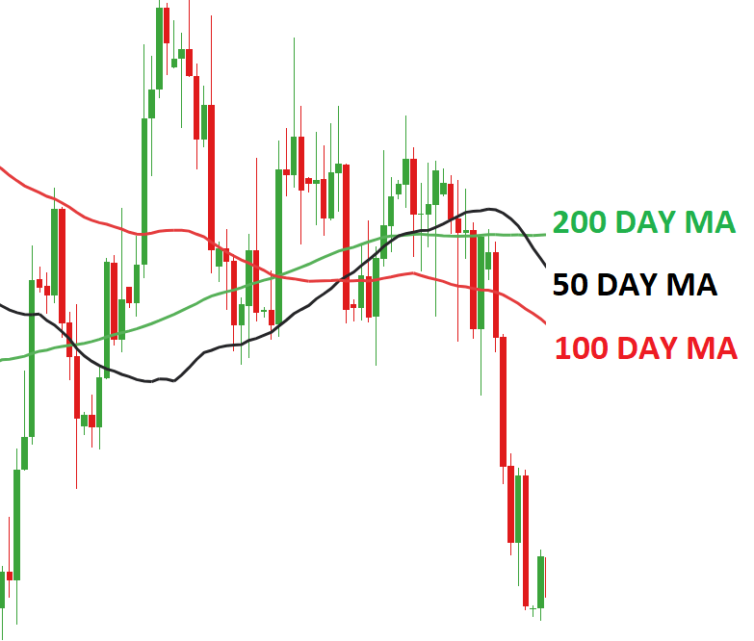
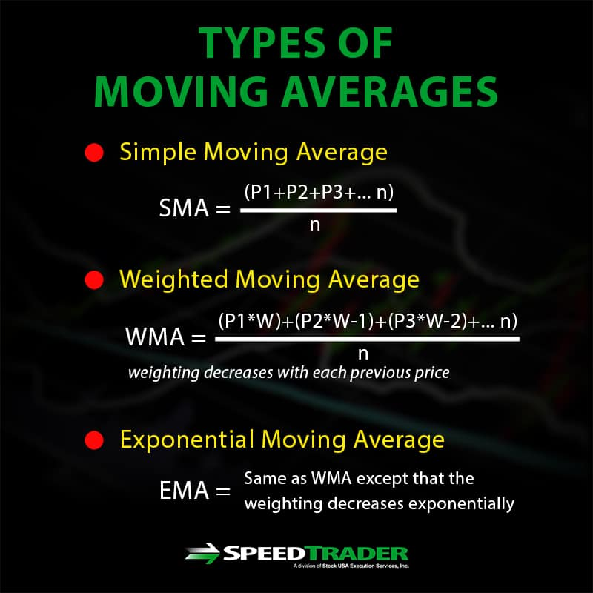

Slide 13
RSI Indicator
RSI (Relative Strength Index) indicator is a momentum oscillator by J. Welles Wilder, Jr., that measures the speed and change of price movements.
It is based upon the difference between the average gains vs. the average loss over a given period.
The RSI compares the magnitude of a stock’s recent gains to the magnitude of its recent losses.
The RSI oscillates between zero and 100. Traditionally the RSI is considered overbought when above 70 and oversold when below 30.

Slide 14
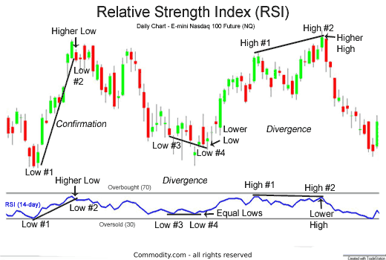

Slide 15
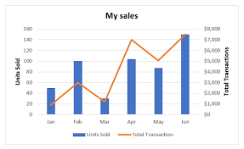
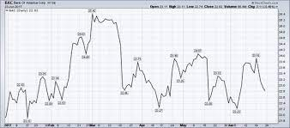
Technical charts
Technical charts help traders take an informed decision while making a financial commitment in the markets. They are a graphical representation of historical price, volume, and time intervals.

Slide 16
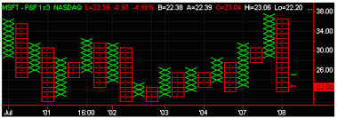
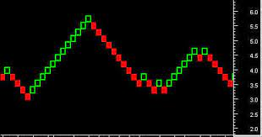
Types of charts
The main chart types used by most traders are
the Line Chart
Candlestick Chart
Point Chart
Figure charts.
These charts are plotted either on arithmetic or logarithmic scale and the analyst then chooses either one.

Slide 17
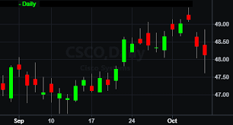
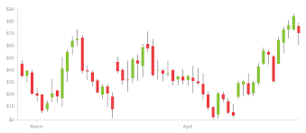
Candlestick charts
Candlestick charts are used by traders to determine possible price movement based on past patterns.
Candlesticks are useful when trading as they show four price points (open, close, high, and low) throughout the period of time the trader specifies.
Many algorithms are based on the same price information shown in candlestick charts.
Trading is often dictated by emotion, which can be read in candlestick charts.

Slide 18
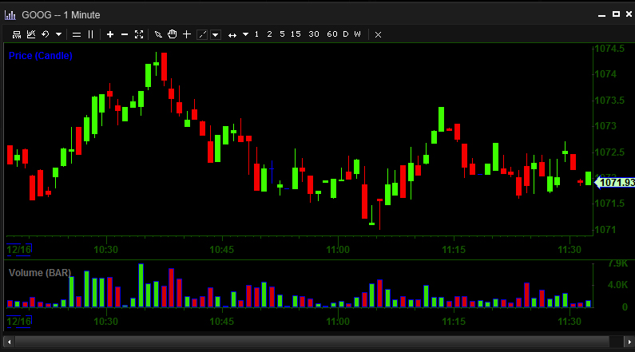

Slide 19
THANK YOU

